Slide 1


Slide 2
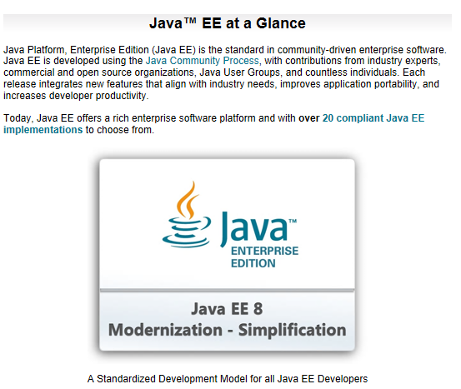
Java Enterprise Edition 8

Slide 3
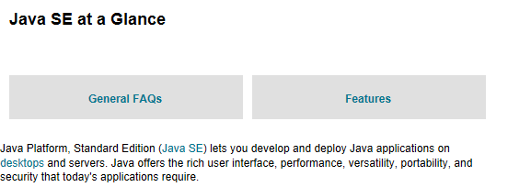
Java SE
Built on top of Java SE, Java EE offers an API and runtime environment for building and running large-scale, multitiered network applications, with security and reliability serving as key goals of the platform

Slide 4
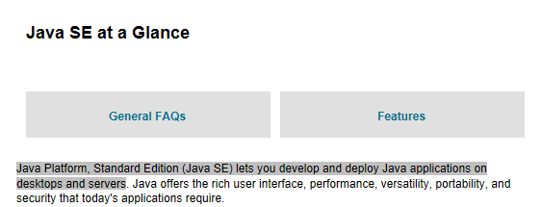
Java Enterprise Edition 8
Built on top of Java SE, Java EE offers an API and runtime environment for building and running large-scale, multitiered network applications, with security and reliability serving as key goals of the platform

Slide 5


Eclipse Enterprise for Java
Not just on eclipse IDE
How further with JSRs : communities/ open source
Compliance Test Kit: Open source ?

Slide 6
Roadmap to Java Enterprise Edition 9 / EE4J 9
Work on Java Enterprise Edition 8 (JEE 8) started in 2014
JEE8 was released 21 September 2017
Java EE is being repositioned for the cloud
emphasizing technologies that support cloud computing, microservices, and reactive programming.
Work should begin on JEE 9 on short term, further enhancing the cloud capabilities.

Slide 7
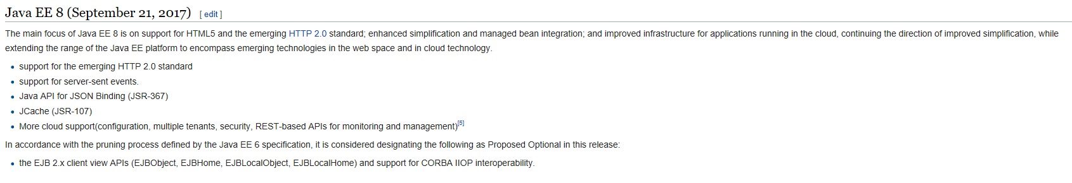

Slide 8
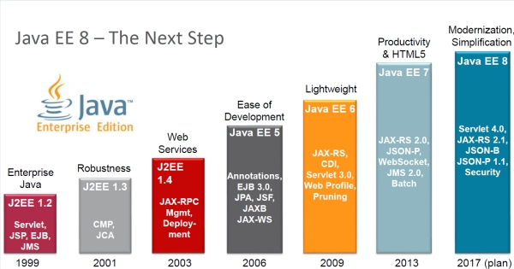
What’s new in JEE8

Slide 9
Java SE 8
JEE8 certified on Java SE 8 (not SE 9)

Slide 10
Java SE 8
JEE8 certified on Java SE 8 (not SE 9)

Slide 11
Microprofile
a baseline platform definition for microservices, hosted now by the Eclipse foundation.
The current 1.1 version of MicroProfile provides a stack that includes CDI, JSON, JAX-RS, and a configuration API

Slide 12
Java EE 8
JSRs – Original plan 2014
Java EE 8 Platform and Web Profile
Context and Dependency Injection 2.0 (CDI)
Java API for JSON Binding 1.0 (JSON-B)
Java Message Service 2.1 (JMS)
Java Servlet 4.0
Java API for RESTful Web Services 2.1 (JAX-RS)
Model-View-Controller 1.0 (MVC)
Java Server Faces 2.3 (JSF)
Java EE Management API 2.0
Java API for JSON Processing 1.1 (JSON-P)
Java EE Security API 1.0
Bean Validation 2.0

Slide 13
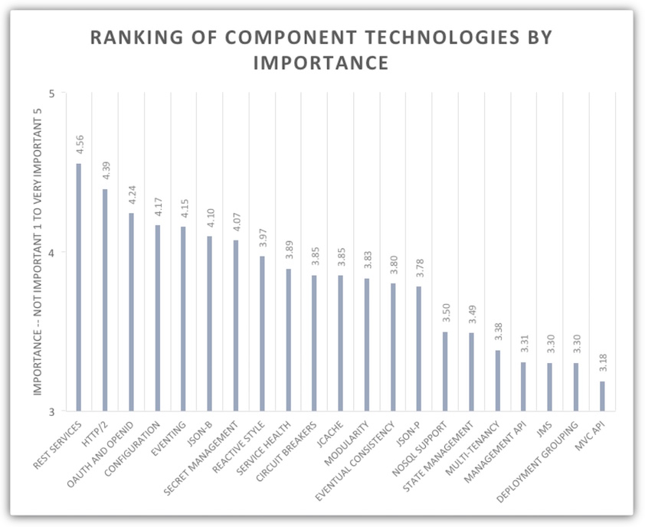
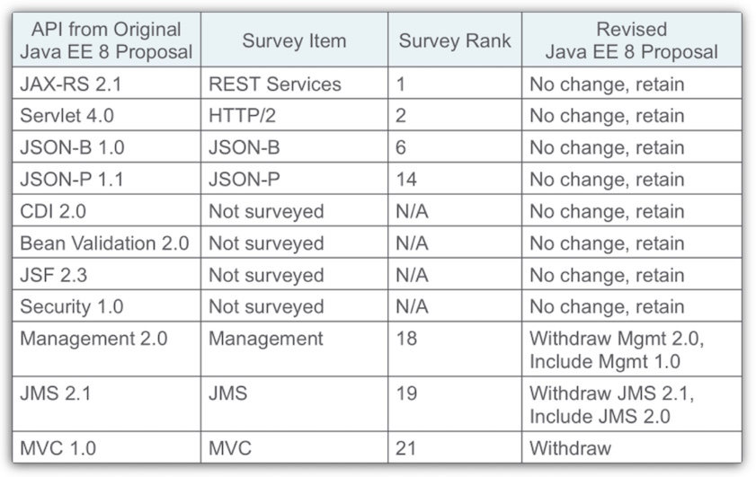
2016 community survey

Slide 14
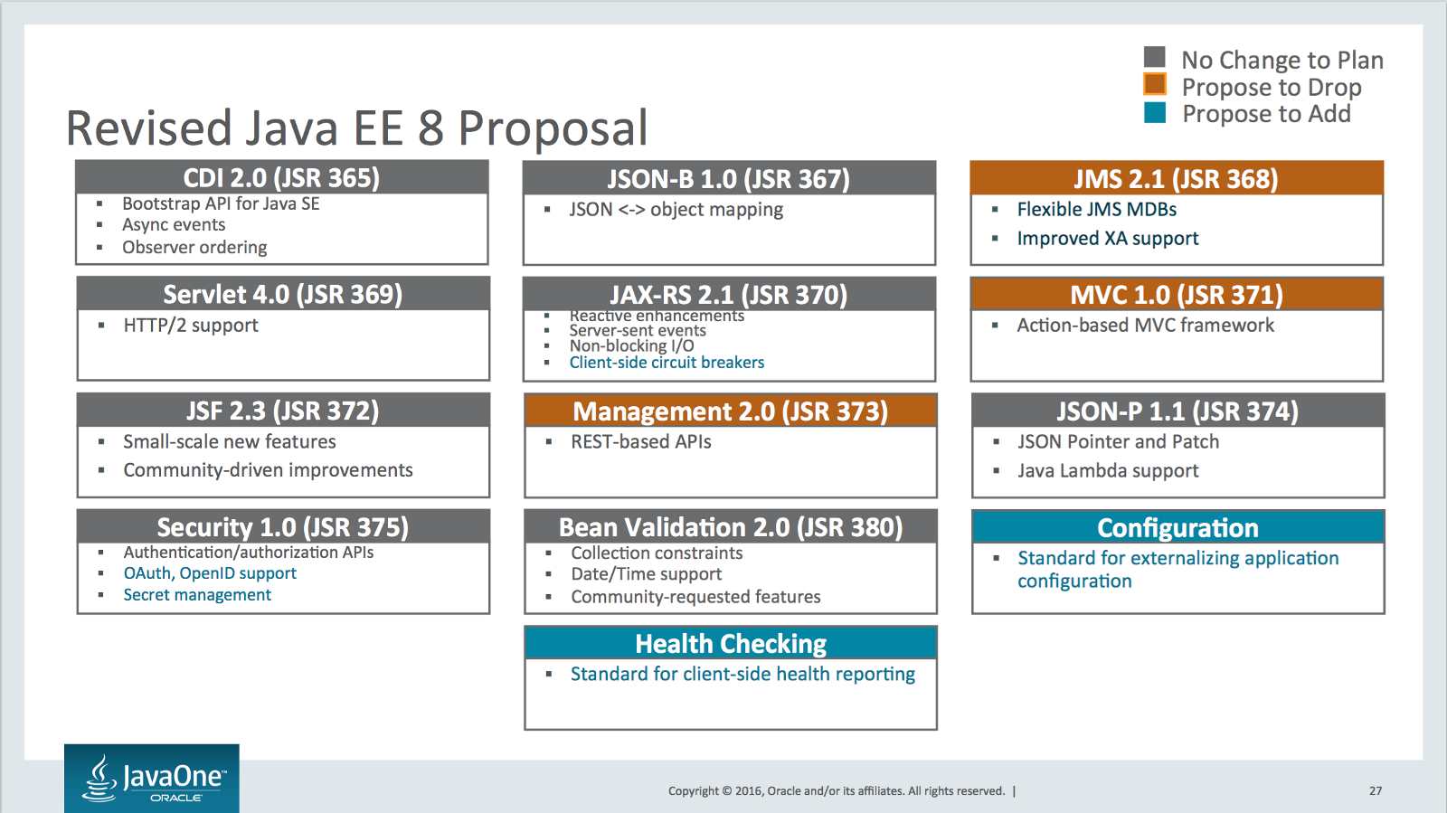
2016 community survey
Summary:
focus on Servlet, REST, JSON
accellerate delivery
deprioritize new standards for management, JMS, MVC

Slide 15
EE4J future
Java EE is being repositioned for the cloud, and the first half of the planned two-part release features technology promoting that goal. As soon as Java EE 8 is out, work will begin on Java EE 9. Currently the goal is to release Java EE 9 within one year.
Already on the roadmap for Java EE 9 is an enhancement to the Java EE Security API, which will include features that didn’t fit into Java EE Security 1.0. Developers can also expect to see deepening support for enterprise development in the cloud, with more Java EE technologies using the reactive manifesto as a blueprint to promote resilience and scalability.
My wishlist for Java EE 9 includes a boost for microservices-friendly technology. Two APIs that would support microservices are Configuration API 1.0 (JSR 382) and Health Check, both dropped for Java EE 8 but under consideration for the next update.
I also welcome the recent announcement that Java EE is being adopted by Eclipse. I expect the open source foundation will embrace greater community involvement from vendors and developers. We should expect an accelerated cadence of Java EE releases, and ongoing enhancements to this powerful enterprise specification.

Slide 16
Java EE 8 new and updated APIs
JSON-B (JavaScript Object Notation Binding), providing a binding layer for converting Java objects to and from JSON messages.
Updates to JSON-P (JSON Processing API), improving the object model.
JAX-RS (Java API for RESTful Web Services) 2.1 reactive client API.
JAX-RS support for server-sent events, offering a one-way channel from a server to a client.
HTTP/2 support in Servlet. Java Servlet provides a programming class to extend server capabilities.
Java EE Security API, accommodating cloud and PaaS paradigms.
Bean Validation 2.0, leveraging Java 8 language constructs for use in validation. Bean Validation enables expression of constraints on object models using annotations.
JavaServer Faces 2.3, for building server-side user interfaces.
CDI (Contexts and Dependency Injection) 2.0, emphasizing asynchronous events.

Slide 17
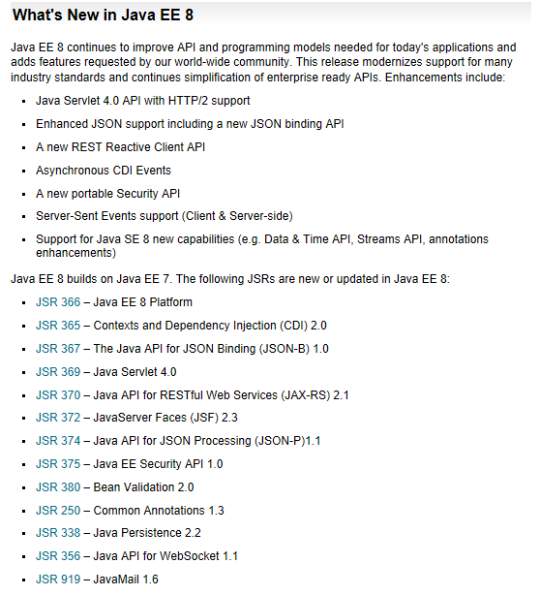
JEE8 – What’s new

Slide 18
Java EE 8 focus areas
Web Tier enhancements / HTTP/2 support
Ease of development / CDI alignment
Security simplification and modernization

Slide 19
What’s new in JEE8
JSR 365: Contexts and Dependency Injection 2.0. The goal is to make CDI modular and separating CDI into Core CDI, Java SE, Java EE.
JSR 374: JSON Processing 1.1. The goal is to include standards like Json pointer, patch and merge patch.
JSR 367: JSON Binding 1.0. The goal is to provide mapping between JSON data and Java objects. It provides a standard support to handle JSON media type for JAX-RS.
JSR 370: RESTful Web Services (JAX-RS 2.1). The goal is to improve server-to-server communication, server-sent events, non-blocking I/O, asynchronous clients with reactive programming, hypermedia API and integration with other JSRs like CDI and other frameworks. The Jersey reference implementation has made good progress but has not yet been approved as a standard.

Slide 20
What’s new in JEE8
JSR 369: JavaTM Servlet 4.0 Specification. The goal is to support for HTTP/2 and compatibility with HTTP 1.1. The early draft review is available.
JSR 372: the next release of Java Server Faces JSF 2.3. It is a mature technology with some improvements such as better CDI and WebSocket integration, Ajax method invocation and date and time support.
JSR 375: Java EE Security API 1.0. The goal is to simplify, standardize, and modernize the Security API across the platform. There is a proposal to simplify managing users and groups. Also improvements related to password aliasing, role mapping, authentication and authorization with CDI support. The second renewal ballot is planned in November.
JSR 380: Bean Validation 2.0. The goal is to leverage Java 8 language constructs, like optionals, date and time API, and repeatable annotations.

Slide 21
Contexts and Dependency Injection 2.0 (JSR 365)

Slide 22


Slide 23
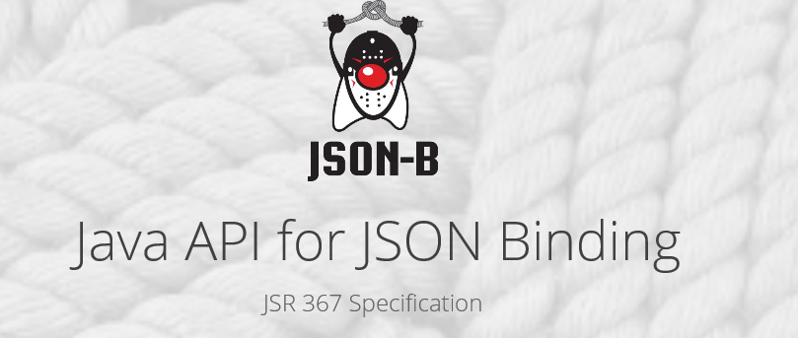

Slide 24
JSON ?
JSON is short for JavaScript Object Notation
A way to store information in an organized, easy-to-access manner
Human-readable
var jason = { “name" : “Jason",
“occupation" : “movie star",
"gender" : "male"
};

Slide 25
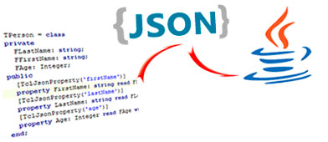

JSON Binding API 1.0 (new) (JSR 367)
Supports serialization and deserialization between Java objects and JSON
Provides default mappings between Java classes and JSON documents.
Supports Collections
Together with JSON Processing : closes the JSON support gap

Slide 26
JSON Binding API 1.0 (new) (JSR 367)
Two interfaces provide entry to the new JSON Binding API:
JsonbBuilder
provides the client access point to the JSON Binding API.
It does this by building Jsonb instances based on set configurations and parameters.
Jsonb
provides serialization and deserialization operations via the methods toJson() and fromJson().

Slide 27
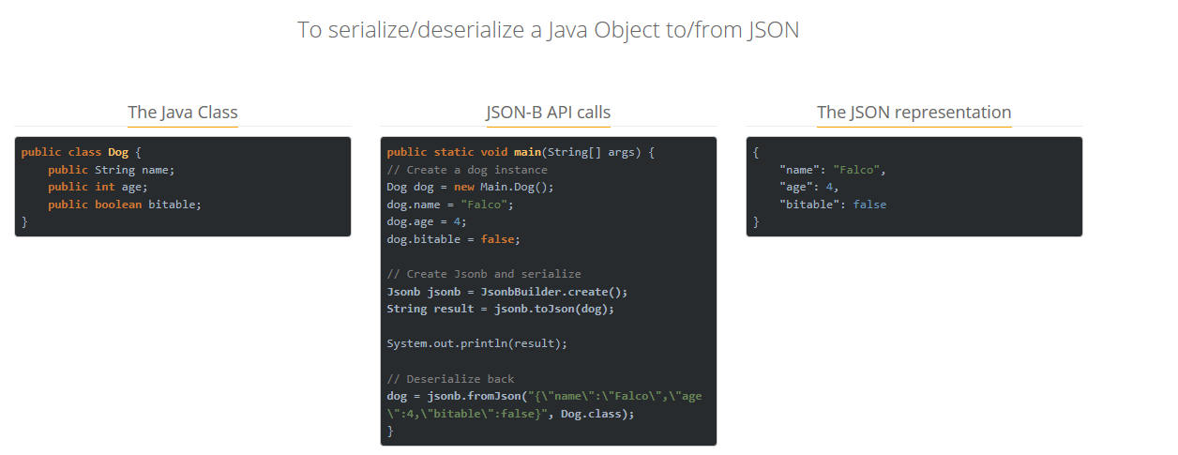
Example JSON Binding

Slide 28
JSON Binding API (new) (JSR 367)
Customization of serialization and deserialization through:
Via annotations (e.g. @JsonbProperty, @JsonNullable)
Via runtime configuration builder (JsonbConfig)

Slide 29
JSON Binding (JSR 367) – customizations via JsonbConfig
// Create custom configuration
JsonbConfig nillableConfig = new JsonbConfig().withNullValues(true);
// Create Jsonb with custom configuration
Jsonb jsonb = JsonbBuilder.create(nillableConfig);
// Use it!
String result = jsonb.toJson(pojo);

Slide 30
JSON Binding (JSR 367) – customization by annotations
@JsonbNillable
@JsonbPropertyOrder(PropertyOrderStrategy.REVERSE)
public class Item {
private String brand;
@JsonbProperty("cost")
@JsonbNumberFormat("#0.00")
private Float price;
private Detail detail;
@JsonbTransient
public String getBrand() {
return brand;
}
@JsonbTransient
public void setBrand(String brand) {
this.brand = brand;
}
// price and detail getters/setter removed for brevity
}
{
"cost": "10.00",
“detail": {
“itemName": “abc",
“itemHeight": “12“
…
}
}

Slide 31


Slide 32
JSON Processing API 1.1
JSON Processing (JSON-P) is a Java API to process (for e.g. parse, generate, transform and query) JSON messages.
It produces and consumes JSON text in a streaming fashion (similar to StAX API for XML)
It allows to build a Java object model for JSON text using API classes (similar to DOM API for XML).

Slide 33
JSON Processing API 1.1 (JSR 374)
Update of JSON-P 1.0 specification, to stay current with emerging standards (RFC 7159)
Support for IETF standards on
JSON Pointer (RFC 6901)
JSON Patch (RFC 6902)
JSON Merge Patch (RFC 7396)
Added helper classes and methods
for better utilization of Java SE 8 Stream Object Model and Streaming API
IETF = Internet Engineering Task Force

Slide 34
JSON Processing API 1.1 (JSR 374) – JSON Pointer
JSON Pointer – IETF RFC 6901
JSON Pointer defines a string syntax for identifying a specific value within a JavaScript Object Notation (JSON) document.

Slide 35
JSON Processing API 1.1 (JSR 374) - JSON Pointer
[
{
“name”:”Duke”,
“gender”:”M”,
“phones” : { “home”:”650-123-4567”
“mobile”:”650-234-5678” }
},
{
“name”:”Jane”,
“gender”:”F”,
“phones” : {“mobile”:”707-555-9999”}
}
]
JsonArray contacts = …;
JsonPointer p =
Json.createPointer(“/0/phones/mobile”);

Slide 36
JSON Processing API 1.1 (JSR 374) – JSON Patch
JSON Patch – IETF RFC 6902
JSON Patch defines a JSON document structure for expressing a sequence of operations to apply to a JavaScript Object Notation (JSON) document;
It is suitable for use with the HTTP PATCH method.
The "application/json-patch+json" media type is used to identify such patch documents.
Expresses a sequence of operations to apply to a JSON document:
“add”, “remove”, “replace”, “move”, “copy”, “test”

Slide 37
JSON Processing API 1.1 (JSR 374) – JSON Patch
[
{
“name”:”Duke”,
“gender”:”M”,
“phones” : { “home”:”650-123-4567”
“mobile”:”650-234-5678” }
},
{
“name”:”Jane”,
“gender”:”F”,
“phones” : {“mobile”:”707-555-9999”}
}
]
JsonPatchBuilder builder =
Json.createPatchBuilder();
JsonPatch patch =
builder.replace(“/0/phones/mobile”, “650-555-1212”)
.remove(“/1”)
.build();

Slide 38
JSON Processing API 1.1 (JSR 374) – JSON Merge Patch
JSON merge patch – IETF RFC 7396
The merge patch format is primarily intended for use with the HTTP PATCH method as a means of describing a set of modifications to a target resource's content.
Operation | Original | Patch | Result
Add | {“a”:”b”} | {“b”:”c”} | {“a”:”b”, “b”:”c”}
Add | {“a”:”b”} | {“a”:”c”} | {“a”:”null”}
Replace | {“a”:”b”} | {“a”:”c”} | {“a”:”c”}
Replace | {“a”:”b”} | {“a”:”null”} | {}
Replace | {“a”:”b”, “b”:”c”} | {“a”:”null”} | {“b”:”c”}
Remove | {“a”:”b”} | {“a”:”b”, “a”:”c”} | {}
Json.createMergePatch(Json.createValue("{\“a\":\"b\"}"))
.apply(Json.createValue("{\“a\":\“c\"}"));

Slide 39
JSON Processing 1.1 (JSR 374) – JsonCollectors + Lambda
Querying JSON has become much simpler with Java 8's introduction of the JsonCollectors class to the javax.json.streams package.
JsonArray topics = jsonObject.getJsonArray("topics")
.stream()
.filter(jv -> ((JsonString) jv).getString().startsWith("C"))
.collect(JsonCollectors.toJsonArray());
{
"topics": [
"Cognitive",
"Cloud",
"Data",
"IoT",
"Java" ]
}

Slide 40


Slide 41
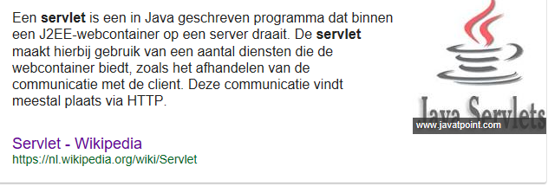
Servlets 4.0 (JSR 369)

Slide 42
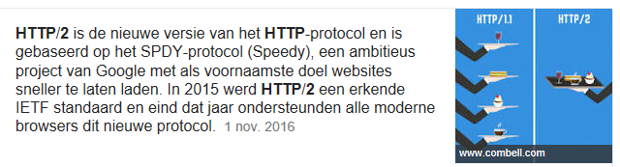
Servlets 4.0 (JSR 369)

Slide 43
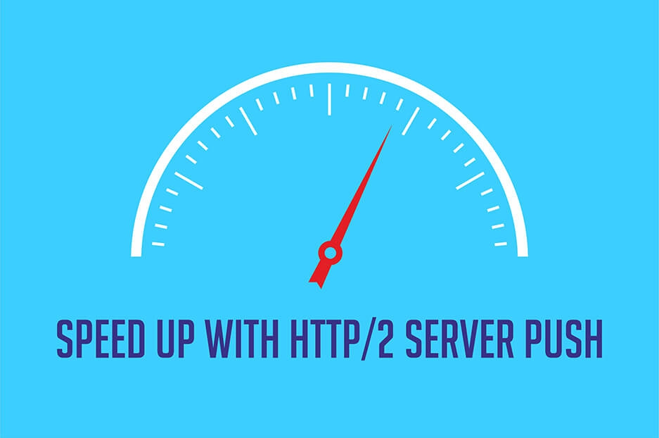
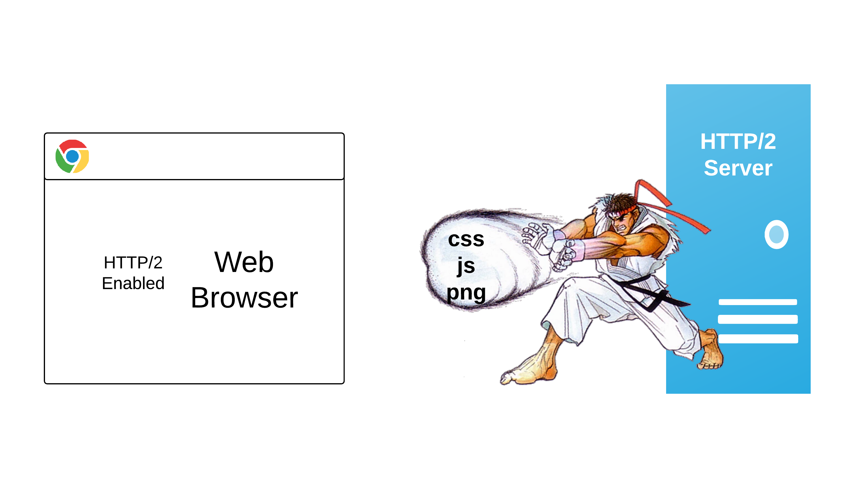
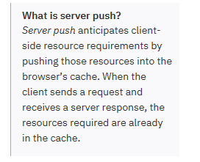
Servlets 4.0 (JSR 369)

Slide 44
Servlets 4.0 (JSR 369)
Servlet 4.0 API
Changes primarily to accommodate the performance-enhancing features of HTTP/2.
Server push is by far the headline feature here.
@Override
protected void doGet(HttpServletRequest request, HttpServletResponse response)
throws ServletException, IOException {
PushBuilder pushBuilder = request.newPushBuilder();
pushBuilder.path("images/header.png").push();
pushBuilder.path("css/menu.css").push();
pushBuilder.path("js/ajax.js").push();
// Do some processing and return JSP that
// requires these resources
}
the path to the header.png is set on the PushBuilder instance via the path() method, and pushed to the client by calling push().

Slide 45


Slide 46
Java EE Security API (JSR 375)
Addition to 2 already existing mechanisms for authenticating web application users:
Java Servlet Spec 3.1
Supports only a small range of credential types
JASPIC (Java authentication Service Provider Interface for Containers)
Powerful + flexible, but rather complicated.
provides an alternative way to configure identity stores and authentication mechanisms, but does not replace existing security mechanisms
The new specification also introduces modern capabilities such as CDI, which existing APIs don't leverage.

Slide 47
Java EE Security API (JSR 375)
Adds new interfaces:
HttpAuthenticationMechanism
IdentityStore
SecurityContext

Slide 48

JEE Security API (JSR 375) - HttpAuthenticationMechanism
HttpAuthenticationMechanism interface
defines three methods:
validateRequest()
secureResponse()
cleanSubject().
Used to authenticate callers of web applications
is specified for the servlet container only.
the specification explicitly excludes other containers such as EJB and JMS.
HttpAuthenticationMechanism type is a CDI bean, available to the servlet container for injection
Can be packaged with application of supplied by container
Interface is modeled on JASPIC ServerAuthModule SPI, trying to alleviate its limitations

Slide 49
JEE Security API (JSR 375) - IdentityStore
IdentityStore interface
identity store abstraction
enables an application to control its identity store in a portable and standard way
Intended for use with HttpAuthenticationMechanism
Identity store is a database that stores user identity data
eg. user name, group membership
used for authentification
used for retrieving info on group memberships.

Slide 50
JEE Security API (JSR 375) – SecurityContext
SecurityContext interface
Used when programmatic security is needed.
programmatic security allows a web application to perform the tests required to grant or deny access to application resources
Methods for authentication:
authenticate()
getCallerPrincipal()
getPrincipalsByType()
isCallerInRole()
hasAccessToWebResource()
Supersedes:
HttpServletRequest.getUserPrincipal()
HttpServletRequest.isUserInRole()
EJBContext.getCallerPrincipal()
EJBContext.isCallerInRole()

Slide 51
JAX-RS 2.1 (JSR 370)
JAX-RS 2.0 voorbeeld Client API:
WebTarget myResource = client.target(“http://example.com/api/hello”);
Future<Customer> fCustomer = myResource.request(MediaType.TEXT_PLAIN)
.async()
.get( new InvocationCallback<Customer>() {
@Override
public void completed(Customer customer) {
// work on the customer
}
@Override
public void completed(Customer customer) {
// oh oh!!
}
}
A Future represents the result of an asynchronous computation.

Slide 52
JAX-RS 2.1 (JSR 370)
JAX-RS 2.1 voorbeeld Reactive Client API:
CompletionStage<String> cs1 = Clientbuilder.newClient()
.target(“http://example.com/api”)
.request()
.rx()
.get(String.class);
cs1.thenAccept(System.out::println);

Slide 53
JAX-RS 2.1 (JSR 370)
JAX-RS 2.0 ServerSentEvents voorbeeld

Slide 54
JSON Processing 1.1 (JSR 374)
JSON Support in Java EE 8
JSON Processing API
Standard API to parse, generate, transform, query JSON
Object Model and Streaming API
similar to DOM and stAX
JSON Binding API
Binding JSON documents to Java objects
similar to JAXB

Slide 55
What’s new in JEE8
JSF 2.3, JPA 2.2, CDI 2.0, JSON-P 1.1, JAX-RS 2.1, and Servlet 4.0. Additionally, you’ll hear about new Java EE 8 APIs such as the new Security API and the new Java API for JSON Binding (JSON-B).

Slide 57


Slide 58


Slide 59


Slide 73



Slide 74


Slide 78


Slide 79


Slide 80


Slide 83


Slide 84


Slide 85


Slide 87


Slide 88


Slide 89


